Slide 1
MTA Exploratory Data Analysis Project
By: Mashari Almuhanna

Slide 2
Overview
Problem
Introduction
advertisement methods are old and not compatible with the traffic and what are they interested on.
The MTA says that it is serving a population of 15.3 million people across a 5,000-square-mile travel area surrounding New York City
So, it has a huge amount of traffic daily. So the advertising companies have a large interest on how the company could benefit from.

Slide 3
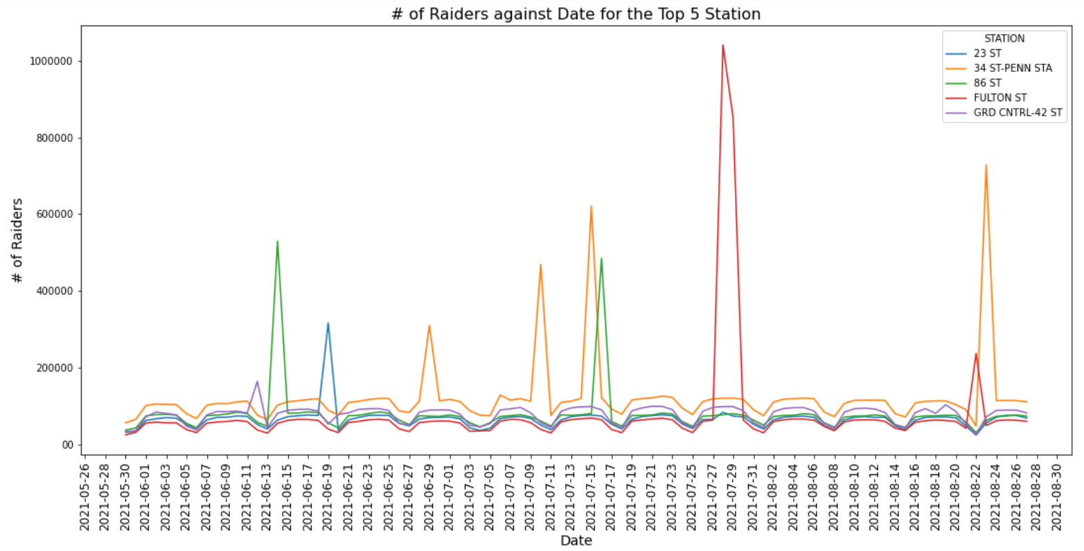
Num of Raiders VS Date for the Top 5 Station
From here we can see that 34 ST-PENN STA station was the busiest station but there are some interesting dates like the 2021-07-28 was the busiest day for the FULTON ST station it was the was the largest traffic between the 5 stations on a day.

Slide 4
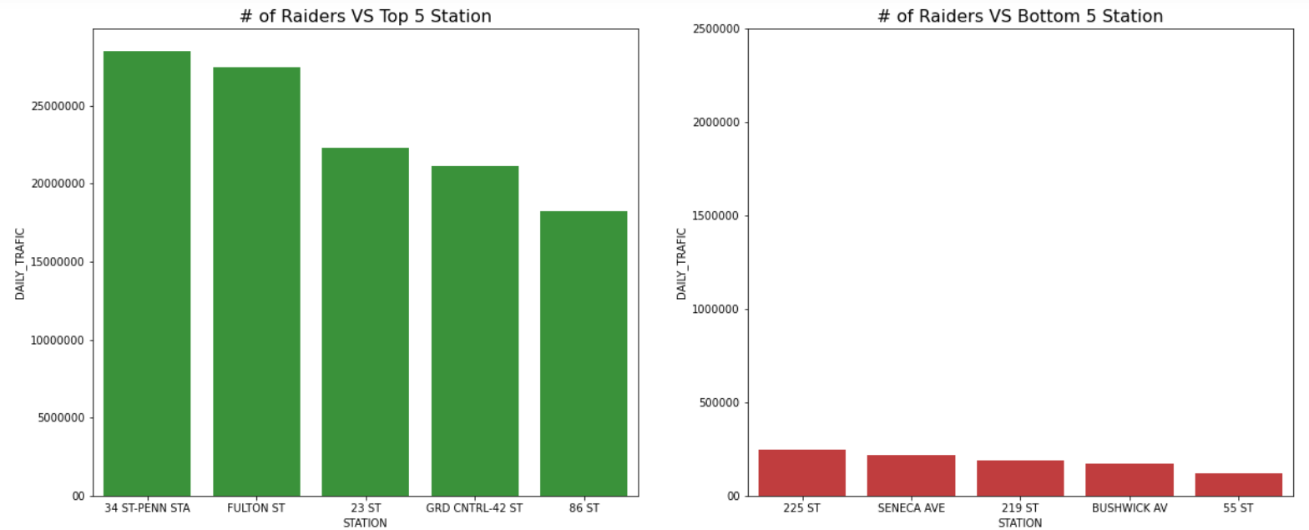
Comparison between the top 5 stations and the bottom 5 stations
From here we can notice that there are a huge deference on traffic between them. like the station 86 ST it has more traffic than the bottom 5 stations combined!.

Slide 5
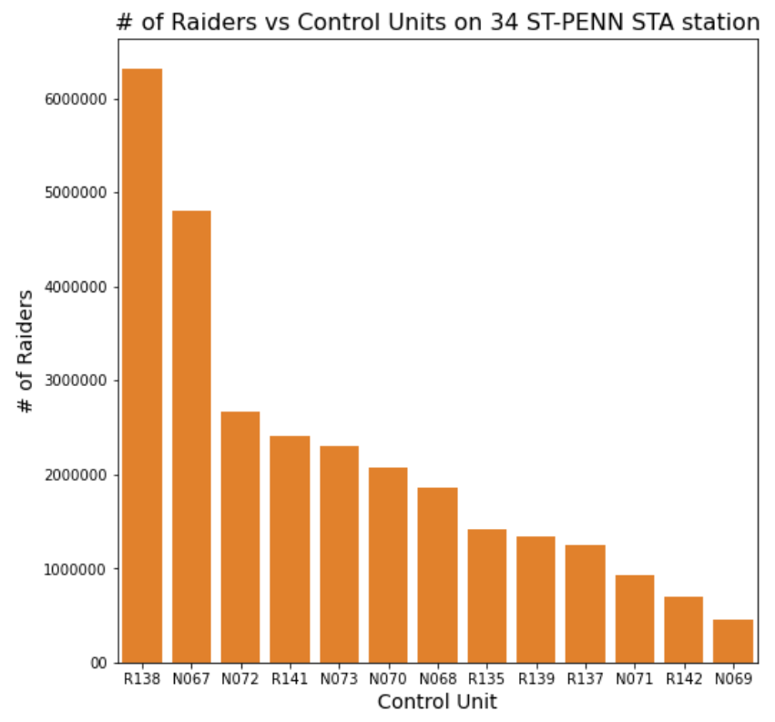
Comparison between the Control Units and number of raiders.
From here we can notice that there are a huge deference on traffic between them. like the station 86 ST it has more traffic than the bottom 5 stations combined!.

Slide 6
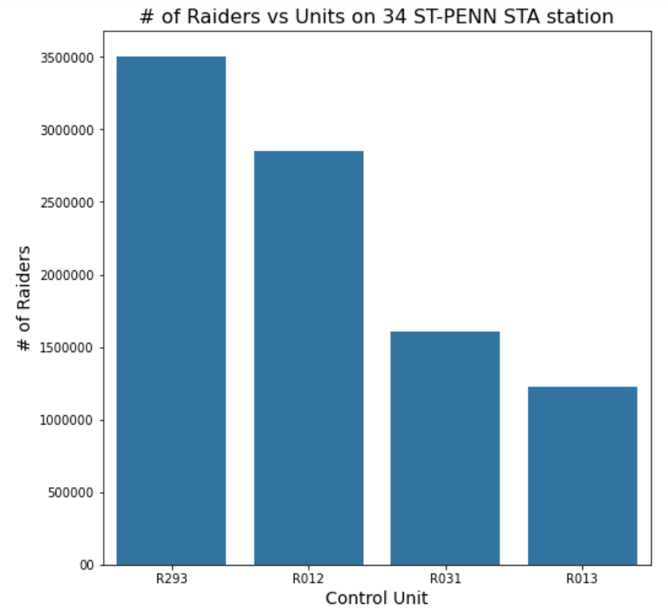
Comparison between the Units and number of raiders.
From this graph we notice that even on units there is a large deference on traffic for each unit for example the unit R293 has more than double raiders on the unit R035.

Slide 7
Conclusion
future work
Insights
I will have better understanding for the people and what method to use for advertising when using analysis based on demographics and geographic data.
▪ Found busy days for stations.
▪ Comparison between the Top Stations and bottom stations. and found there is a very large deference.
▪ Have better understand that where is the busiest Control Units.
▪ Have better understand that where is the busiest Units.

